Slide 1
Python Fundamentals
Ride the Snake!
Notes:
1 min

Slide 2
Crash Course Review of Languages
There are a few major types of languages:
Assembly – x64, ARM, MIPS, RISC-V (machine code representation)
Systems – C/C++, Swift, Go, D, Rust (“on the metal”, statically typed)
Managed – Java, Kotlin, Groovy, C#, F# (VM-based, statically typed)
Scripting – JavaScript, BASIC, R, MATLAB, Python (dynamically typed)
Generally, there are tradeoffs between flexibility and performance. Lower-level languages usually involve compilation for performance reasons.
Notes:
4.5 min

Slide 3
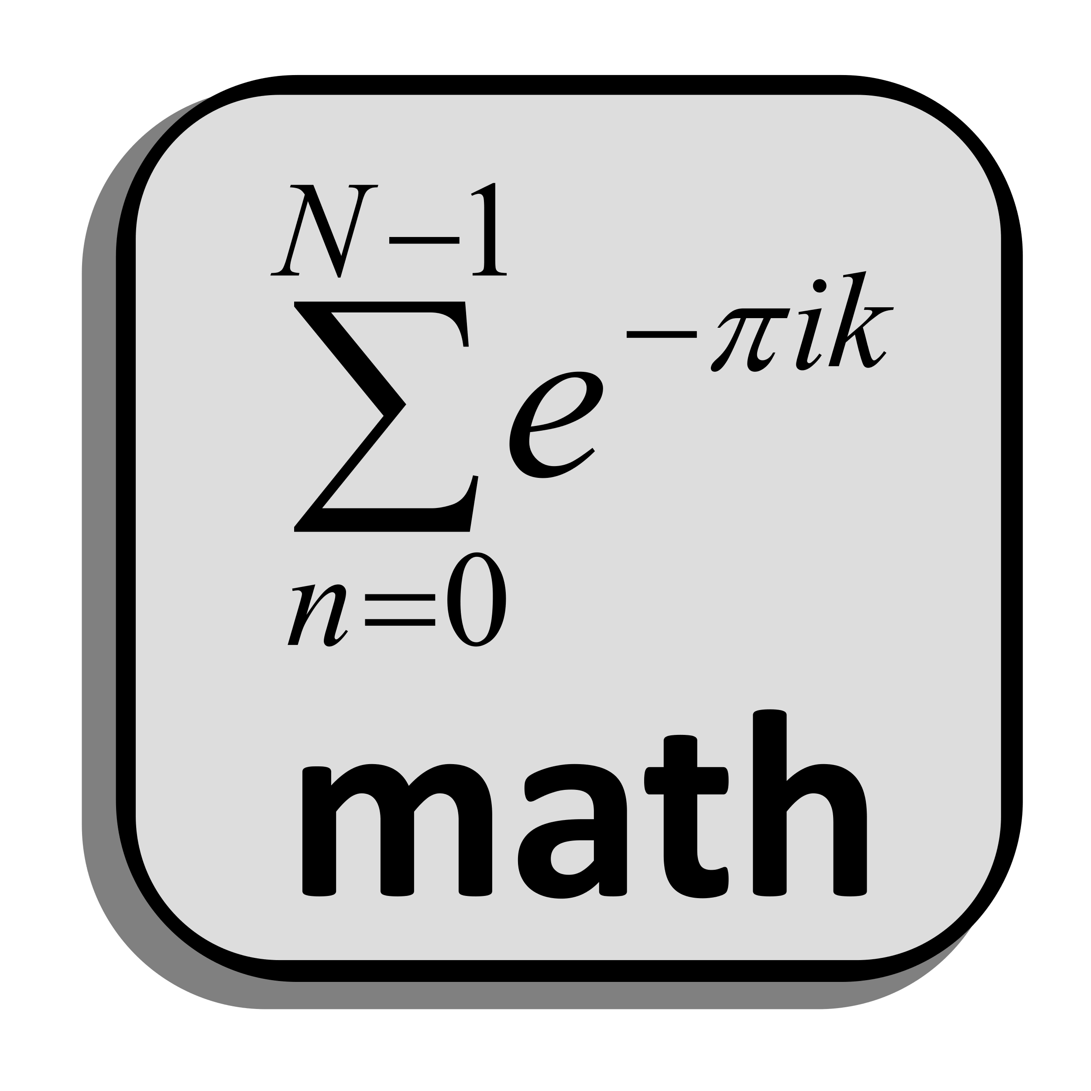
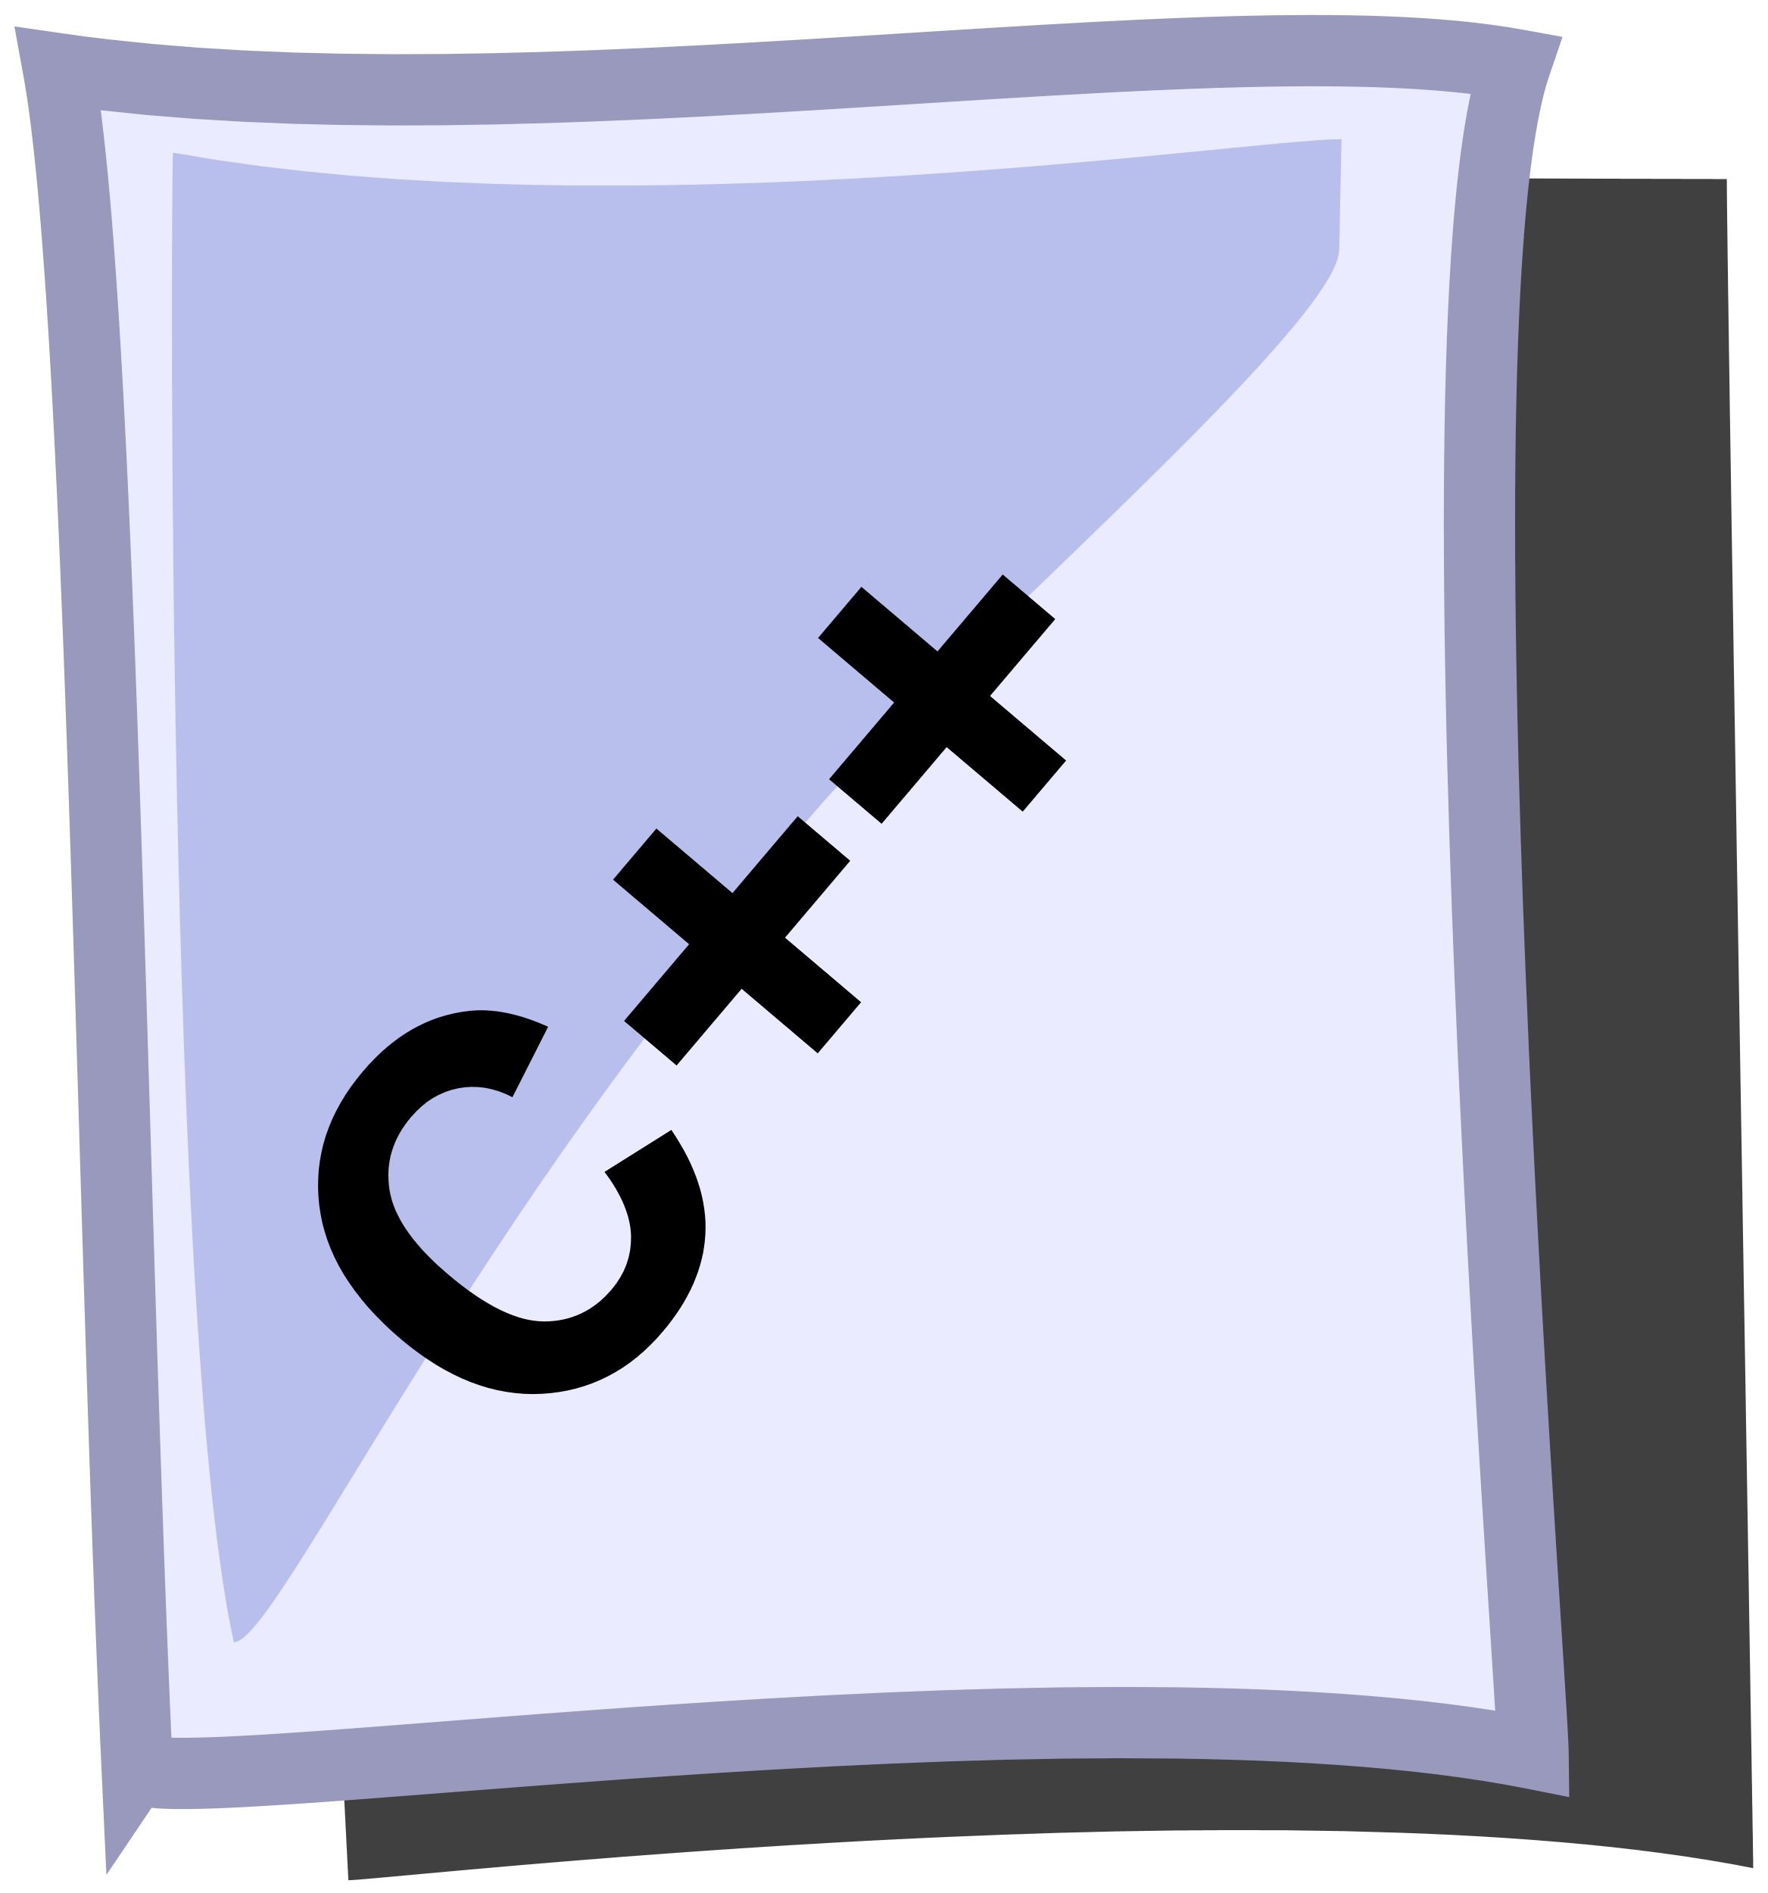


Assembly & Systems Languages
For performance, source is often compiled directly into machine code:
Compiler
Ye Olde Machine Code
01001011010010
11011101010101 0101000111000
0000111101010
1110111010101
0101000101011
0000111010110
Notes:
0.5 min

Slide 4


Managed Languages
In managed languages, the byte code and VM allow for cross-platform use:
Compiler
Ye Olde Byte Code
VM
Ye Olde Machine Code
Java
01001011010010
11011101010101 0101000111000
0000111101010 1110111010101
0101000101011
01001011010010
11011101010101 0101000111000
0000111101010
1110111010101
0101000101011
One Time
Every Time
Notes:
2 min

Slide 5


Scripting Languages
We can achieve flexibility – at the cost of performance – through interpretation:
Interpreter
VM
Ye Olde Machine Code
01001011010010
11011101010101 0101000111000
0000111101010
1110111010101
0101000101011
Every Time
Interpreters generally process code line-by-line.
Notes:
1 min

Slide 6
What is Python?
Python is a scripting language designed with simplicity as a core tenet.
Beautiful is better than ugly.
Explicit is better than implicit.
Simple is better than complex.
Complex is better than complicated.
From The Zen of Python (PEP 20) [See also: Pythonic]
Notes:
1.5 min

Slide 7
But Scripting sucks… right?
Scripting languages costs us in efficiency – but we can mitigate.
Compilation to interpreter byte code (“.pyc”)
Use system languages for bottlenecks (C++/Rust)
Integrate new I/O models (async / wait)
Simplify parallelism (thread / process pools)
Notes:
2 min

Slide 8
Interactive Python
We can directly run lines of code through the console (interactive) interpreter:
jjb@localhost:~$ python3
Python 3.8.0 (default, Oct 28 2019, 16:14:01)
[GCC 8.3.0] on linux
Type "help", "copyright", "credits" or "license" for more information.
>>> print("Ride the snake!!!")
Ride the snake!!!
>>> a = 40
>>> b = 2
>>> c = a + b
>>> c
42
>>> exit()
jjb@localhost:~$
Identifier rules are like other languages: letters, underscores, digits*
Notes:
The interpreter comes up as interactive console; it passes instructions to the VM to be run from the standard input.
That means we can type any line of valid code, and it will be executed on the spot.
You’ll notice that there are no semicolons at the end of lines – and that’s not the only difference (more coming up).
Look ma – no variable types! Variables are dynamic references, and they can be assigned to instances of different types. There are no primitives!
7.5 min

Slide 9
Python Source Files
Python source files have little required structure – but there are guidelines.
print("Hello world!")
print("Goodbye cruel world...")
print(fake_variable_name)
jjb@localhost:~$ python3 hello.py
Hello world!
Goodbye cruel world...
Traceback (most recent call last): …
def main():
print("Hello world!")
print("Goodbye cruel world...")
main()
if __name__ == "__main__":
main()
jjb@localhost:~$ python3 hello.py
jjb@localhost:~$
← ???
jjb@localhost:~$ python3 hello.py
Hello world!
Goodbye cruel world...
jjb@localhost:~$
Notes:
Source files are executed line by line – if the syntax is “right”, but the symbols are wrong, it won’t catch the errors!
That means that we could just have a bunch of lines of code in the source - the end.
We might want a main function, so I'll declare one (main).
Note that Python doesn't have curly braces; instead, we have to indent consistently - I use two or four spaces.
But if we run with just the main defined, nothing happens! Why?
It’s because we're declaring a function *object* (more later), but we aren't ever invoking it!
We'll have to invoke it in the source by calling the function – using “main()”.
Unfortunately, this is sort of messy. What if we wanted to use this code later in another project?
Thankfully, the “__name__” dunder is automatically declared by the interpreter when executing from stdio, originating script, or interpreter.
8 min

Slide 10
Best Practices
Python Style Guide (PEP 8):
Match existing style
docstring, dunders, imports, code
Avoid unnecessary space
"""This is the sandwich module. As you might expect,
This module makes a sandwich.
"""
import lunchmeat.Spam
import breadslice.Wheat
__author__ = "Earl of Sandwich"
def make_sandwich(top, filling, bottom):
# The __add__ operator is overloaded here.
return top + filling + bottom
def main():
spammer = make_sandwich(Wheat(), Spam(), Wheat())
if __name__ == "__main__":
main() # Call main function
Identifier Type
Modules | short
Var, & Func. | lower_snake_case
Classes | UpperCamelCase
Constants | UPPER_SNAKE_CASE
Notes:
4 min

Slide 11
Language Keywords
These keywords cannot be used as identifiers:
False | await | else | import | pass
None | break | except | in | raise
True | class | finally | is | return
and | continue | for | lambda | try
as | def | from | nonlocal | while
assert | del | global | not | with
async | elif | if | or | yield
Notes:
1 min

Slide 12
Arithmetic Operators
Python arithmetic has some familiar and some new symbols:
Name | Operator | Function | Example | Val | Prc
Parentheses | () | Elevate precedence / grouping | (3 + 4) * 4 | 28 | 1
Exponentiation | ** | Raise a number to an exponent | 3 ** 2 | 9 | 2
Negative / Positive | -, + | Designate sign | -(5) | -5 | 3
Multiply / Divide / Modulus | *, /, % | Multiply or divide numbers | 7 / 2 | 3.5 | 4
Divide-with-Floor | // | Divide & apply floor (int. divide) | 7 // 2 | 3 | 4
Matrix Multiply* | @ | Multiply matrices (dot-product) | *LATER! ☺ | - | -
Addition / Subtraction | +, - | Add or subtract two numbers | 3 – 3.5 | -0.5 | 5
In addition, Python has string concatenation (+) and compound assignment (+=).
Notes:
3.5

Slide 13
Fundamental Types
Python has several built-in data types:
Category | Name | Description
None | None | Python‘s null type
Numeric | int | Integers
 | float | Floating point numbers
Iterable | list | Mutable list of elements (sequence)
 | tuple | Immutable list of elements (sequence)
 | str | Immutable run of code points (sequence)
 | range | Immutable run of integers (not sequence)
Other Collections | set | Unordered collection of distinct elements
 | dict | Unordered map of distinct keys to values
Note that this is not an exhaustive list! There are others (file, object, etc.)
Notes:
6 min

Slide 14
Control Structures
Python has some familiar control structures with new keywords.
def is_order_cheezbrgr(haz_ketchup, haz_cheez, haz_meet):
if not haz_cheez or not haz_meet:
print("WAT.")
result = ""
while result != "Y" and result != "N":
print("You want cheezbrgr [Y/N]? ", end='')
result = input()
if result == "Y":
return True, "☺"
elif result == "N":
return False, "☹"
else:
return None # Should be unreachable
return True, "☺"
Notes:
9 min
Whole lecture, second run: 67 min (second run)

Slide 15
Functional Programming
It’s Not Lisp
Notes:
1 min

Slide 16
Quick Review: Functional Programming
In functional programming…
New data is created, but old data is not destroyed (immutable)
Functions are stateless (same data → same results of call)
Functions are pure (no side effects)
Functions are first-class
Functional programming approaches can often simplify our code.
Notes:
4 min

Slide 17
What is “Syntactic Sugar”?
Languages add syntactic sugar make language features more accessible by...
Combining operations commonly used together
Simplifying complexity of source code (readability)
Providing abstractions of common patterns
Examples of syntactic sugar in other languages:
[ ] operator for pointers (C/C++): pointer[n] → *(pointer+n)
Ternary expression (C-family): a = (b > 2) ? b : 5 → if (b > 2)…
Compound assignment (various): a += 5 → a = a + 5
Notes:
3.5 min

Slide 18
List Comprehensions
We can create a list as a modification of an iterable via list comprehension.
numbers = ["One", "Two", "Three", "Four"]
potatoes = [num + "Potato" for num in numbers]
print(potatoes)
print(["0" + str(digit) for digit in range(0, 10)]
['OnePotato', 'TwoPotato', 'ThreePotato', 'FourPotato’]
['00', '01', '02', '03', '04', '05', '06', '07', '08', ‘09']
Note that there are no tuple comprehensions, but we will look at generators!
Notes:
5.5 min

Slide 19
Generators
A generator is a special function that is iterable (via the yield construct).
def month_range(start, length, month_step):
months = ("Jan", "Feb", "Mar", "Apr", "May", "Jun",
"Jul", "Aug", "Sep", "Oct", "Nov", "Dec")
for offset in range(0, length, month_step):
month = (start + offset) % 12
yield months[month]
my_range = month_range(0, 14, 2)
print(my_range)
print(list(my_range))
<generator object month_range at 0x7f0d03e409e0>
['Jan', 'Mar', 'May', 'Jul', 'Sep', 'Nov', 'Jan']
A call to a generator creates a generator object that tracks iteration state.
Notes:
12 min

Slide 20
Generator Comprehensions
We can create a generator comprehension as a shorthand generator:
def is_prime(number):
… # A bunch are on the interwebz – efficiency varies!
prime_list = [num for num in range(0, 20) if is_prime(num)]
prime_gen = (num for num in range(0, 20) if is_prime(num))
print(prime_list)
print(prime_gen)
print(*prime_gen)
[2, 3, 5, 7, 11, 13, 17, 19]
<generator object <genexpr> at 0x7f341885b9e0>
2 3 5 7 11 13 17 19
As with a full function, this creates a generator object.
Notes:
7 min

Slide 21
Lambda Expressions
Like in Java or C++, lambda expressions allow us to use anonymous functons:
users = [["Rob", 25, "English"], ["Jane", 27, "Spanish"]]
def compare_no_case(lhs, rhs):
return lhs.lower() == rhs.lower()
def find_user(userlist, username, cmp=str.__eq__):
namelist = list(zip(*users))[0] # zip(user[0], user[1], …)
for index, entry in enumerate(namelist):
if cmp(entry, username):
return index, userlist[index]
return None, None # If user wasn’t found, return None.
compare_lower = lambda lhs, rhs: (lhs.lower() == rhs.lower())
print(find_user(users, "jane", compare_lower))
(1, ["Jane", 27, "Spanish"])
Notes:
8.5 min

Slide 22
Iteration Tools (“itertools”)
The python itertools module offers support types for functional programming:
Infinite Iterators
count(start[, step]): yield from start by step (count(1,2) → 1,3,5,7,…)
cycle(iterable): yield from iterable in a cycle (cycle("αβγ") → α,β,γ,α…)
repeat(elem[, n]): yield elem up to n times or forever (repeat(5,3) →5,5,5)
Finite Iterators
islice(iterable[, start], stop[, step]): iterator for a slice
izip(iter1, iter2, …): iterator for a zip
This is just a subset; see the module for more features!
Notes:
5 min

